Slide 1

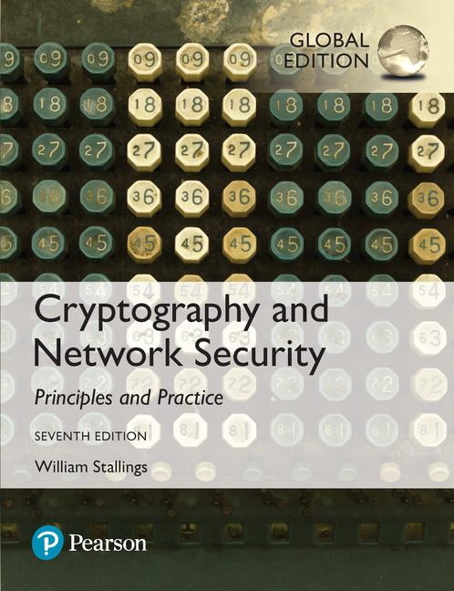
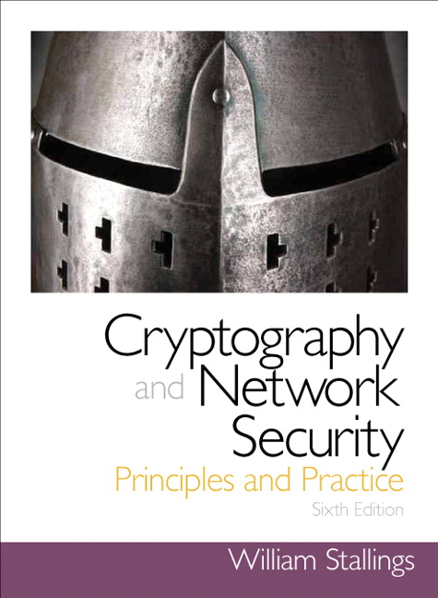
Cryptography and Network Security
Seventh Edition, Global Edition
by William Stallings
Notes:
Lecture slides prepared for “Cryptography and Network Security”, 7/e, by William Stallings, Chapter 10 – “Other Public-Key Cryptosystems”.

Slide 2
Chapter 10
Other Public-Key Cryptosystems
Notes:
This chapter begins with a description of one of the earliest and simplest PKCS: Diffie-
Hellman key exchange. The chapter then looks at another important scheme, the
Elgamal PKCS. Next, we look at the increasingly important PKCS known as elliptic
curve cryptography. Finally, the use of public-key algorithms for pseudorandom number
generation is examined.

Slide 3
Diffie-Hellman Key Exchange
First published public-key algorithm
A number of commercial products employ this key exchange technique
Purpose is to enable two users to securely exchange a key that can then be used for subsequent symmetric encryption of messages
The algorithm itself is limited to the exchange of secret values
Its effectiveness depends on the difficulty of computing discrete logarithms
Notes:
The first published public-key algorithm appeared in the seminal paper by Diffie
and Hellman that defined public-key cryptography [DIFF76b] and is generally
referred to as Diffie-Hellman key exchange. A number of commercial products
employ this key exchange technique.
The purpose of the algorithm is to enable two users to securely exchange a
key that can then be used for subsequent symmetric encryption of messages. The
algorithm itself is limited to the exchange of secret values.
The Diffie-Hellman algorithm depends for its effectiveness on the difficulty of
computing discrete logarithms. Briefly, we can define the discrete logarithm in the
following way. Recall from Chapter 2 that a primitive root of a prime number p is
one whose powers modulo p generate all the integers from 1 to p - 1. That is, if a
is a primitive root of the prime number p , then the numbers
a mod p , a² mod p , . . . , a^{p-1} mod p
are distinct and consist of the integers from 1 through p - 1 in some permutation.
For any integer b and a primitive root a of prime number p , we can find a
unique exponent i such that
b = a^{i} (mod p ) where 0 ≤ i ≤ (p - 1)
The exponent i is referred to as the discrete logarithm of b for the base a , mod p .
We express this value as dlog_{a,p} (b ). See Chapter 2 for an extended discussion of
discrete logarithms.

Slide 4
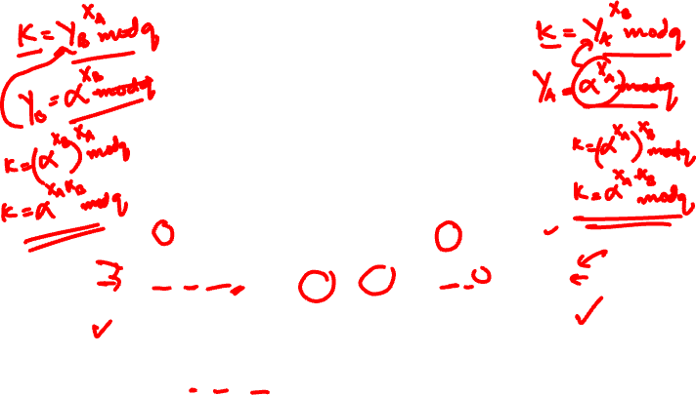
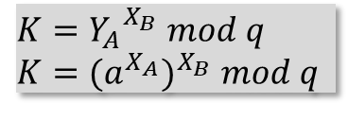
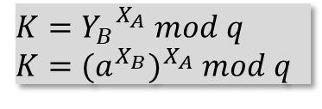
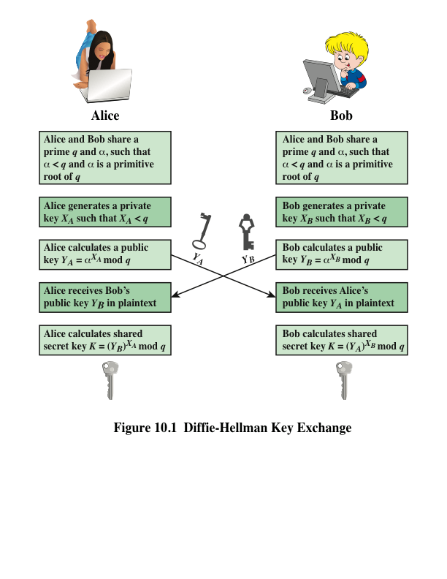
$$K={Y_{B}}^{X_{A}} mod q$$
$$K={(a^{X_{B}})}^{X_{A}} mod q$$
$$K={Y_{A}}^{X_{B}} mod q$$
$$K={(a^{X_{A}})}^{X_{B}} mod q$$
Notes:
Figure 10.1 summarizes the Diffie-Hellman key exchange algorithm. For this
scheme, there are two publicly known numbers: a prime number q and an integer a
that is a primitive root of q .

Slide 5

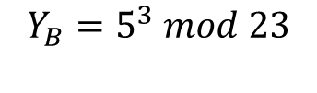
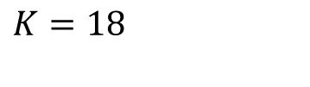

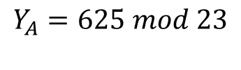
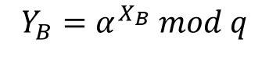
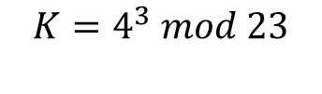

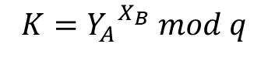
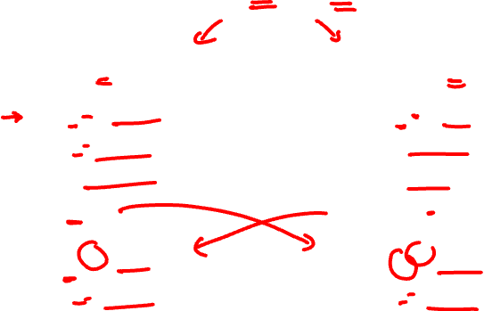
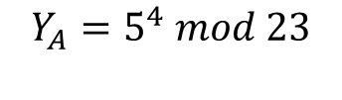
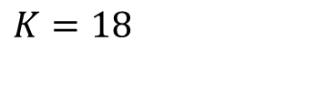
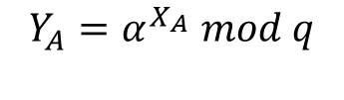

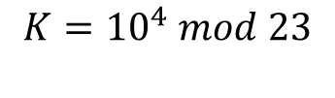

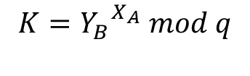
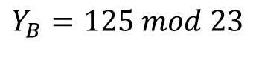
Let$q=23 and α=5$
ALICE
BOB
$$X_{A}=4$$
$$X_{B}=3$$
$$Y_{A}=α^{X_{A}} mod q$$
$$Y_{B}=α^{X_{B}} mod q$$
$$Y_{A}=5^{4} mod 23$$
$$Y_{B}=5^{3} mod 23$$
$$Y_{A}=625 mod 23$$
$$Y_{B}=125 mod 23$$
$$Y_{A}=4$$
$$Y_{B}=10$$
$$K={Y_{B}}^{X_{A}} mod q$$
$$K={Y_{A}}^{X_{B}} mod q$$
$$K={10}^{4} mod 23$$
$$K=4^{3} mod 23$$
$$K=18$$
$$K=18$$

Slide 6
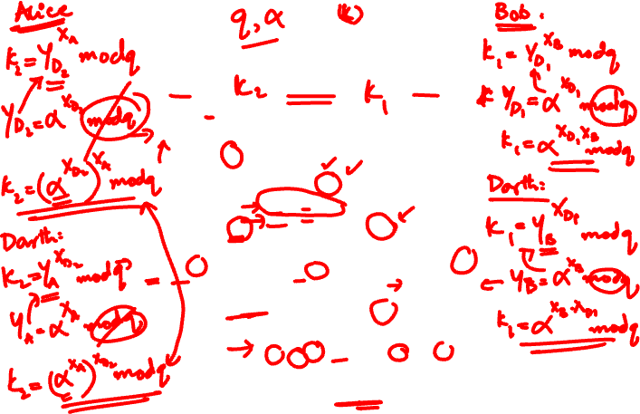
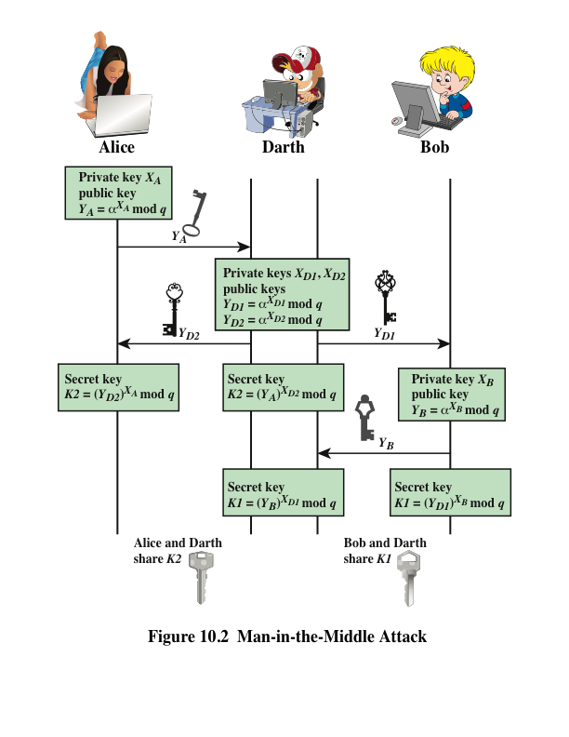
Notes:
The protocol depicted in Figure 10.1 is insecure against a man-in-the-middle attack.
Suppose Alice and Bob wish to exchange keys, and Darth is the adversary. The
attack proceeds as follows (Figure 10.2).
Darth prepares for the attack by generating two random private keys X_{D1} and X_{D2} and then computing the corresponding public keys Y_{D1} and Y_{D2}
Alice transmits Y_{A} to Bob.
Darth intercepts Y_{A} and transmits Y_{D1} to Bob. Darth also calculates K2 = (Y_{A} )^ X_{D2} mod q
Bob receives Y_{D1} and calculates K1=(Y_{D1} )^ X_{B} mod q
Bob transmits Y_{B} to Alice.
Darth intercepts Y_{B} and transmits Y_{D2} to Alice. Darth calculates K1=(Y_{B} )^ X_{D1} mod q
Alice receives Y_{D2} and calculates K2=(Y_{D2} )^ X_{A} mod q .
At this point, Bob and Alice think that they share a secret key, but instead Bob and Darth share secret key K1 and Alice and Darth share secret key K2. All future communication between Bob and Alice is compromised in the following way:
Alice sends an encrypted message M: E(K2, M).
Darth intercepts the encrypted message and decrypts it, to recover M.
Darth sends Bob E(K1, M) or E(K1, M'), where M' is any message. In the first case, Darth simply wants to eavesdrop on the communication without altering it. In the second case, Darth wants to modify the message going to Bob.
The key exchange protocol is vulnerable to such an attack because it does not authenticate the participants. This vulnerability can be overcome with the use of digital signatures and public- key certificates.

Slide 7

ElGamal Cryptography
Announced in 1984 by T. Elgamal
Public-key scheme based on discrete logarithms closely related to the Diffie-Hellman technique
Used in the digital signature standard (DSS) and the S/MIME e-mail standard
Global elements are a prime number q and a which is a primitive root of q
Security is based on the difficulty of computing discrete logarithms
Notes:
In 1984, T. Elgamal announced a public-key scheme based on discrete logarithms, closely related to the Diffie-Hellman technique [ELGA84, ELGA85]. The ElGamal cryptosystem is used in some form in a number of standards including the digital signature standard (DSS) and the S/MIME email standard.
As with Diffie-Hellman, the global elements of ElGamal are a prime number q and a, which is a primitive root of q. User A generates a private/public key pair. The security of ElGamal is based on the difficulty of computing discrete logarithms, to recover either x given y, or k given K .
The security of Elgamal is based on the difficulty of computing discrete
logarithms.

Slide 8
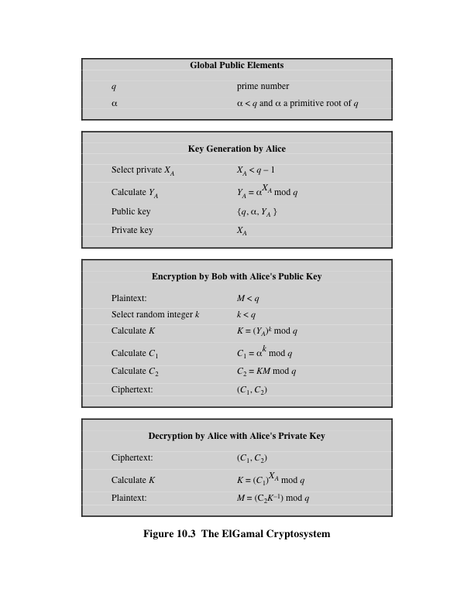
Random Number
Notes:
Figure 10.3 summarizes the ElGamal Cryptosystem. It corresponds to Figure 9.1a.
Alice generates a public/private key pair; Bob encrypts using Alice’s public key; and
Alice decrypts using her private key.

Slide 9
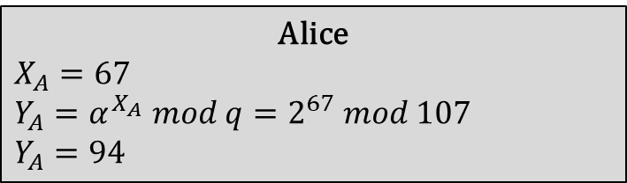

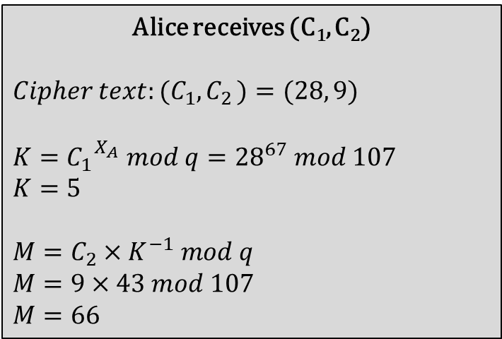
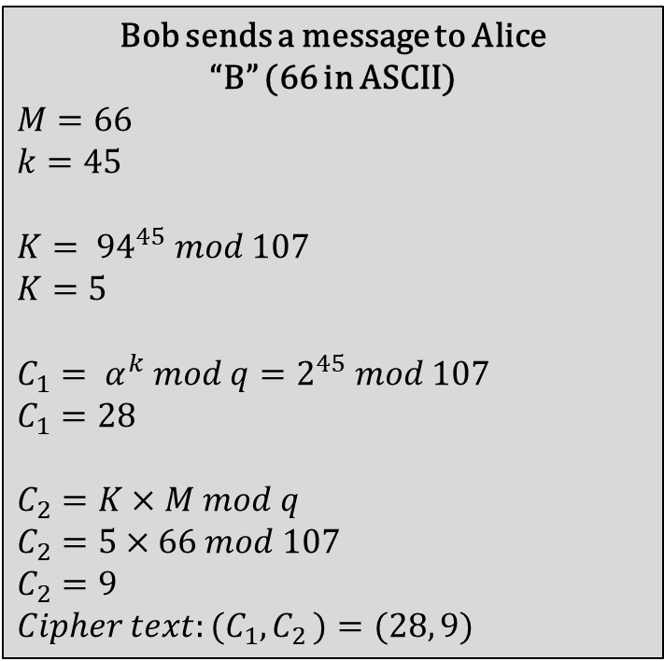
Let$q=107 and α=2$
Alice
$$X_{A}=67$$
$$Y_{A}=α^{X_{A}} mod q=2^{67} mod 107$$
$$Y_{A}=94$$
Alice receives (C₁, C₂)
$$Cipher text:{(C}_{1}{, C}_{2})=(28, 9)$$
$$K={C_{1}}^{X_{A}} mod q={28}^{67} mod 107$$
$$K=5$$
$$M={C_{2}×K}^{−1} mod q$$
$$M=9×43 mod 107$$
$$M=66$$
Bob sends a message to Alice
“B” (66 in ASCII)
$$M=66$$
$$k=45$$
$$K= {94}^{45} mod 107$$
$$K=5$$
$$C_{1}= α^{k} mod q=2^{45} mod 107$$
$$C_{1}=28$$
$$C_{2}=K×M mod q$$
$$C_{2}=5×66 mod 107$$
$$C_{2}=9$$
$$Cipher text:{(C}_{1}{, C}_{2})=(28, 9)$$

